Slide 1
GamesCenter

Slide 2
Table of contents
01
Team members
02
Project idea
03
Technologies used
04
Work plan

Slide 3
01
Team members

Slide 4

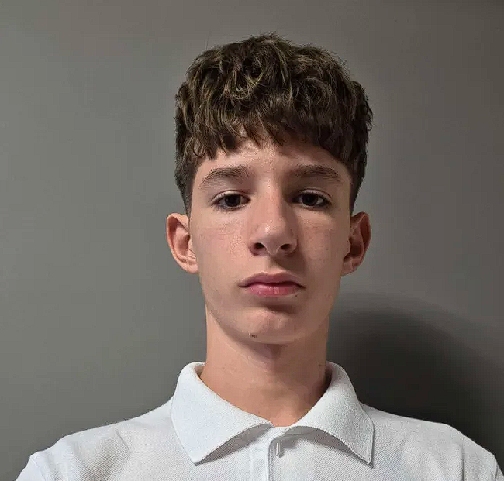
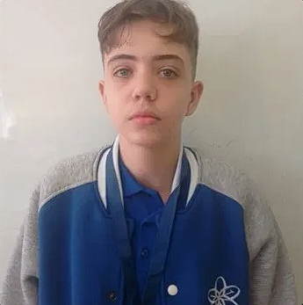
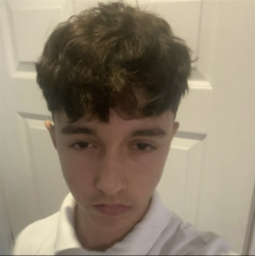
01. Team members
Vasil Zarakyan
Back-End Developer
Nikola Dimitrov
Front-End Developer
-
Presiyan Tenev
Designer
Beray Nuri
Scrum trainer

Slide 5
02
Project idea

Slide 6
02. Project idea
Our team decided to create a simple, yet entertaining game, named GamesCenter. You pick whatever u feel like playing , and start thinking. Our games were made to challenge the brains of our players.

Slide 7
03
Technologies used

Slide 8





03. Technologies used

Slide 9
04
Work plan

Slide 10
04. Work plan
Make up a feasible idea
Distribute the tasks
Start writing the code
2.1. Main menu
2.2. The rest of the structure
4. Create a documentation
5. Create a presentation

Slide 11
Now let's jump into the game!

